Slide 2
Introduction to Probabilistic Reasoning
Logic and Knowledge Graphs are about statements of fact
Do we always have complete knowledge about the world?
Are our “facts” always precise?
Logic can handle incomplete knowledge
It cannot handle uncertain knowledge

Slide 3
Recap
You have previously studied some elementary forms of probabilistic reasoning
We are now going to build up the Bayesian Network, a probabilistic representation that is an attempt to model the causal relationships between a set of random variables
We will first need to remind ourselves of some basic concepts from probability theory

Slide 4
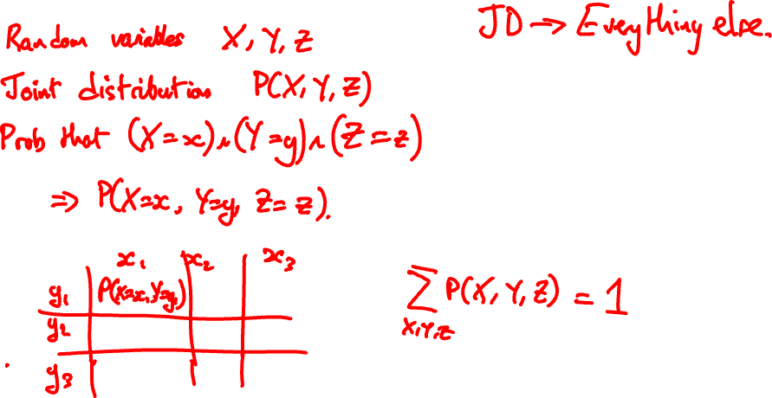
The Joint Distribution

Slide 5
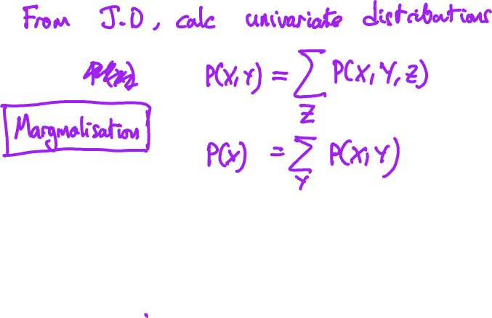
The Sum Rule

Slide 6
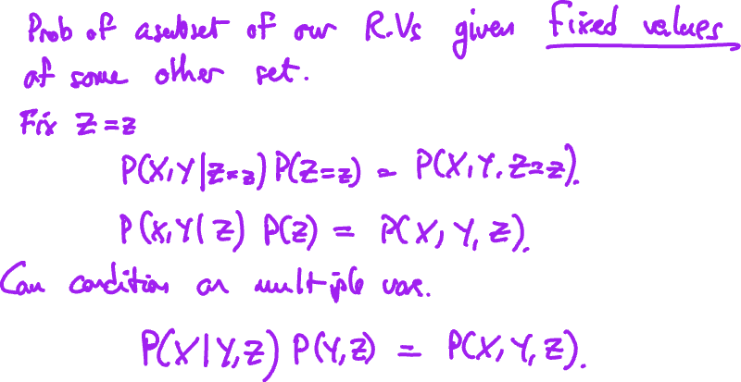
Conditional Probability

Slide 7
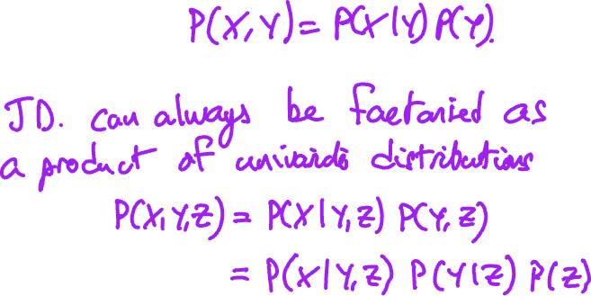
The Product Rule

Slide 8
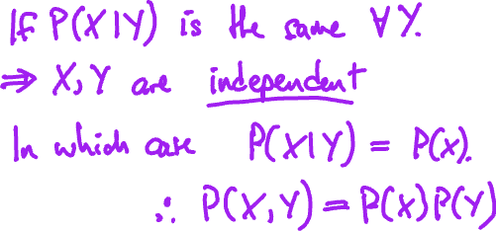
Independence

Slide 9
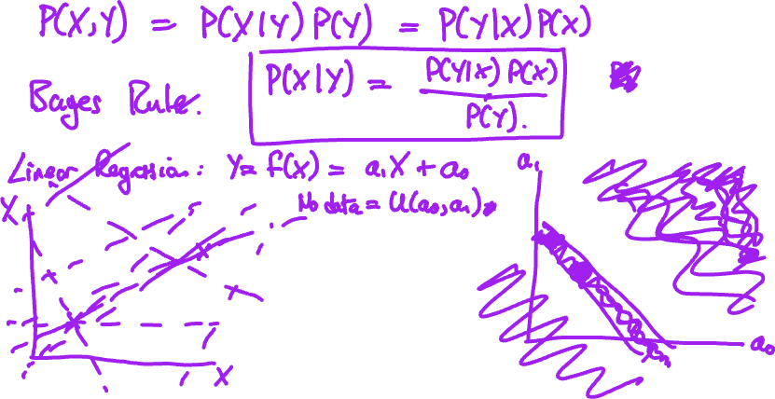
Bayes Rule

Slide 10
Exercises 13

Slide 11
Conditional Independence
Independence is a powerful and useful assumption in many problems
But it does not apply in all situations
Joint distribution is hard to work with in large problems
Can we give the joint distribution some structure akin to independence but more general?

Slide 12
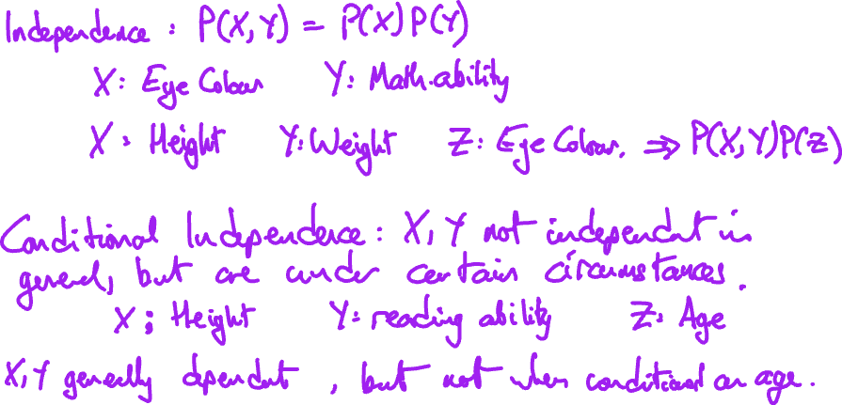
Conditional Independence

Slide 13
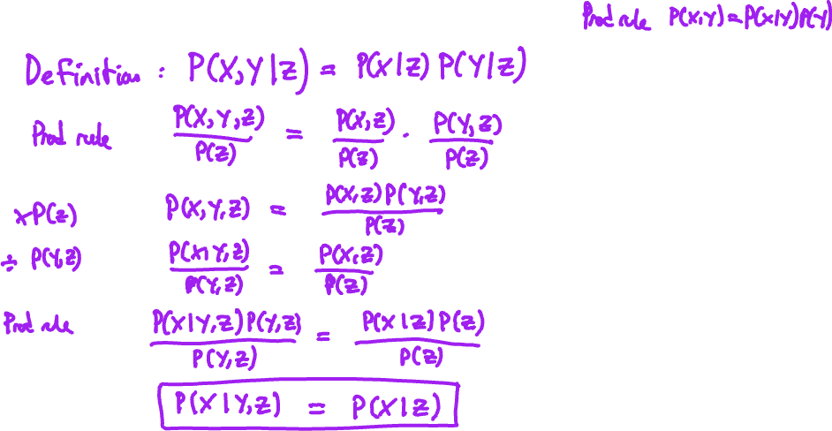
Conditional Independence

Slide 14
Conditional Independence

Slide 15
Exercises 14: Conditional Independence

